Slide 1
Human Voice Classification & Clustering System
Machine Learning Based Voice Gender Prediction
Name:
Avanthi UC

Slide 2
Problem Statement
Develop a machine learning system that:
Classifies human voice profiles (Male/Female)
Identifies natural clusters using unsupervised learning
Compares multiple ML models
Deploys the best model using Streamlit
We aim to build an end-to-end ML pipeline that not only classifies voices but also explores hidden patterns using clustering.

Slide 3
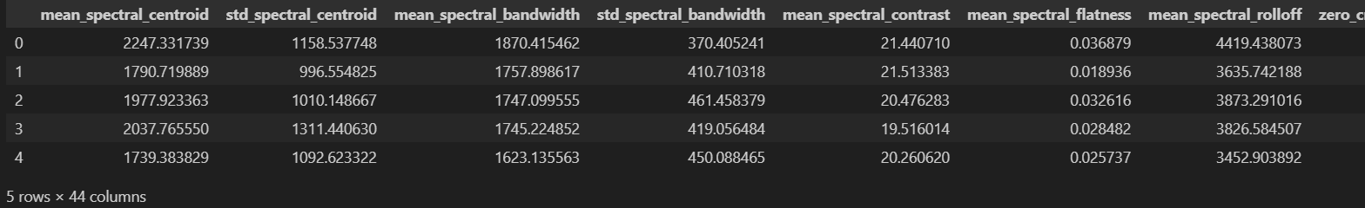
Dataset Overview
Dataset Details
Pre-extracted acoustic features
MFCC features
Spectral features
Cleaned dataset used
Top 20 important features selected
Performed feature selection to reduce dimensionality and improve performance.

Slide 4
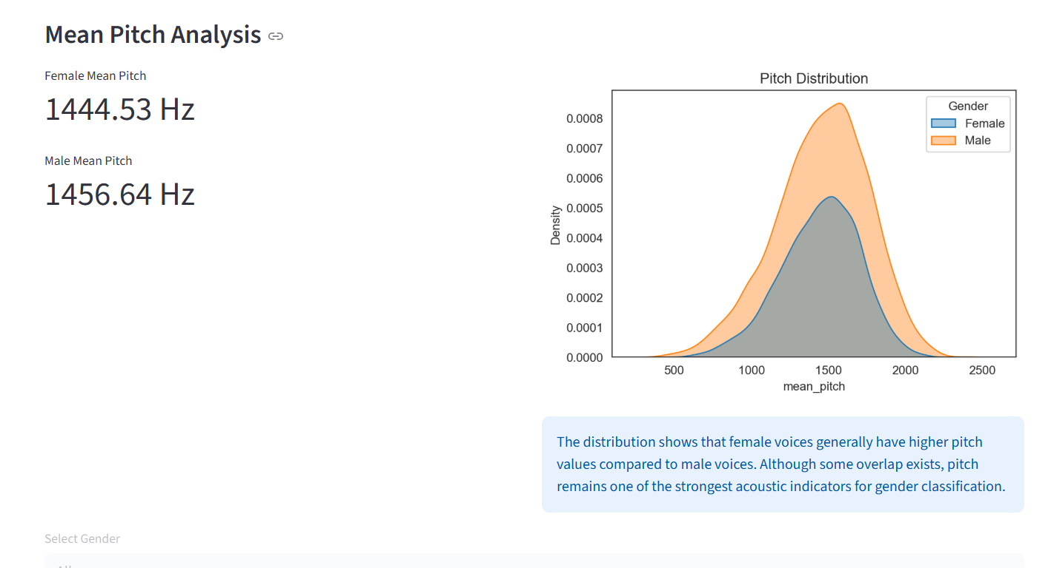
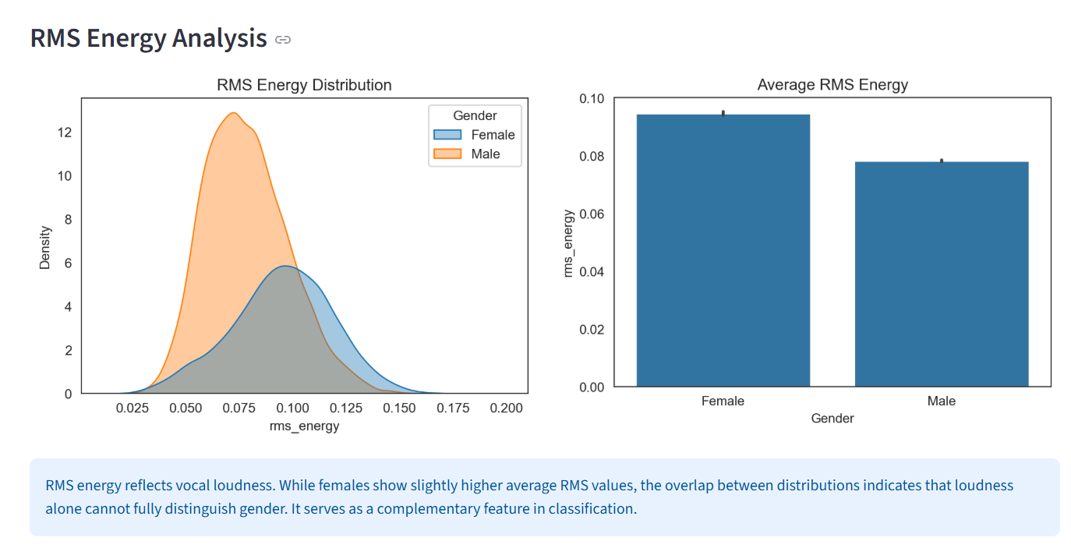
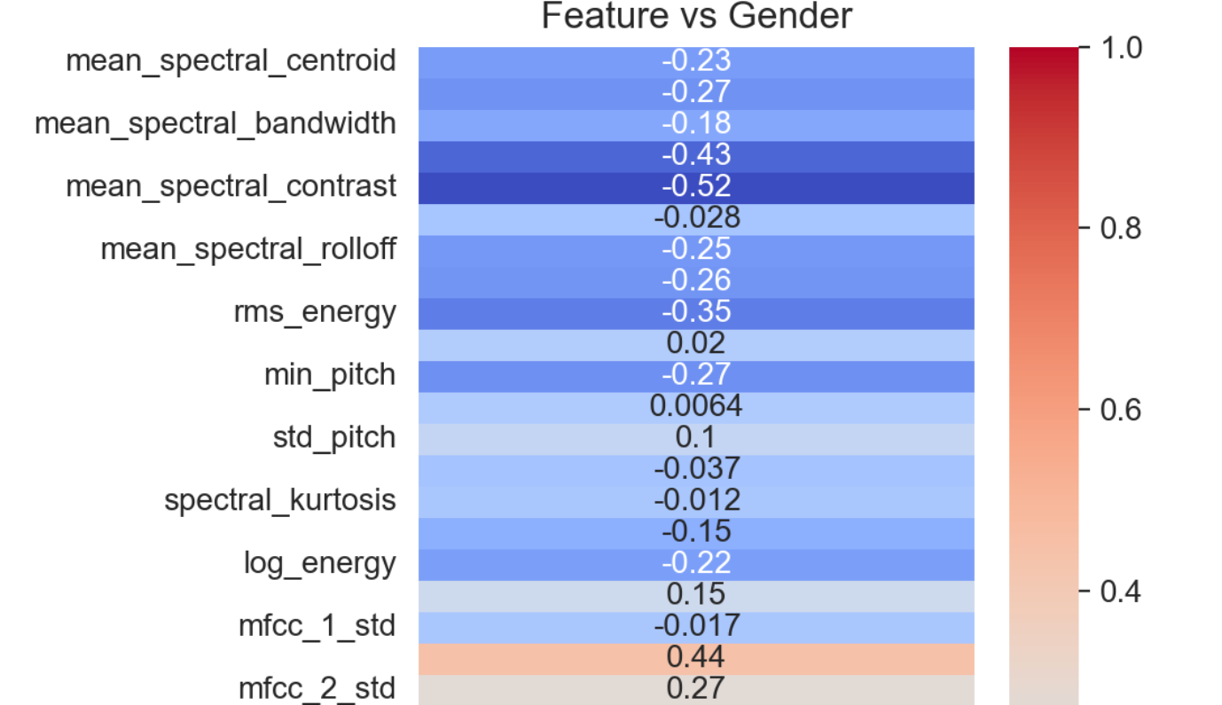
Exploratory Data Analysis
EDA Highlights
Correlation heatmap
Feature distributions
Class balance check
Important features identified

Slide 5
MODEL COMPARISON
Model | Accuracy | Approx Errors | Notes
Logistic Regression | 99.13% | 26 | Linear baseline
Random Forest | 99.43% | 17 | Ensemble
XGBoost | 99.53% | 14 | Boosting
LightGBM | 99.70% | ~9 | Strong boosting
MLP | 99.86% | 4 | Neural network
SVM | 99.93% | 2 | Best performer

Slide 6
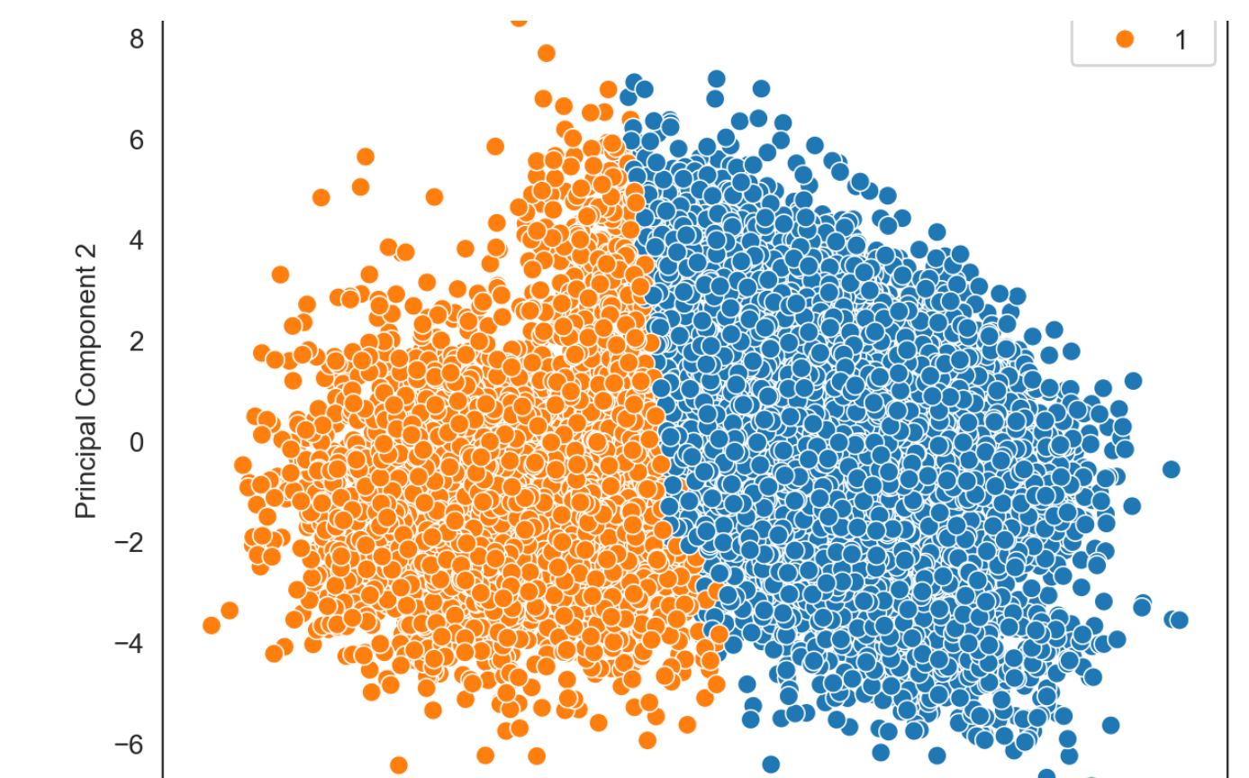
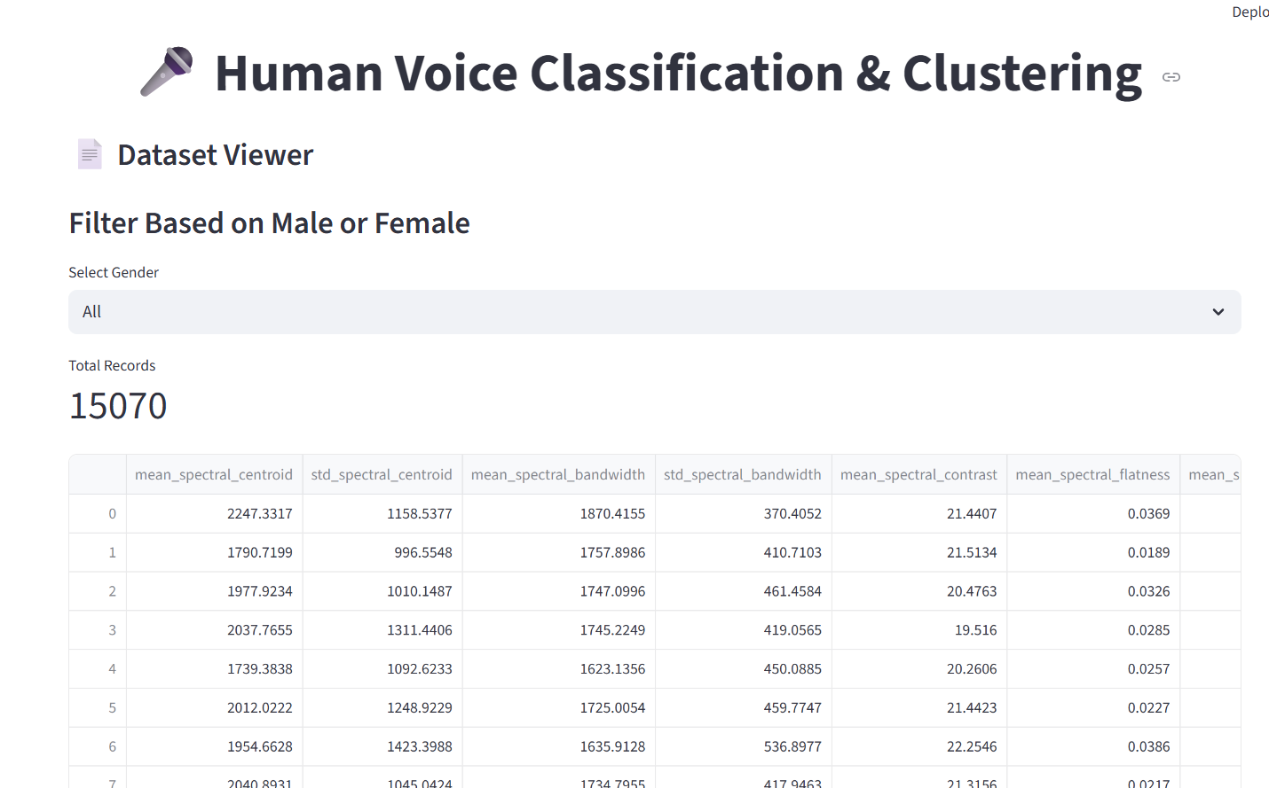
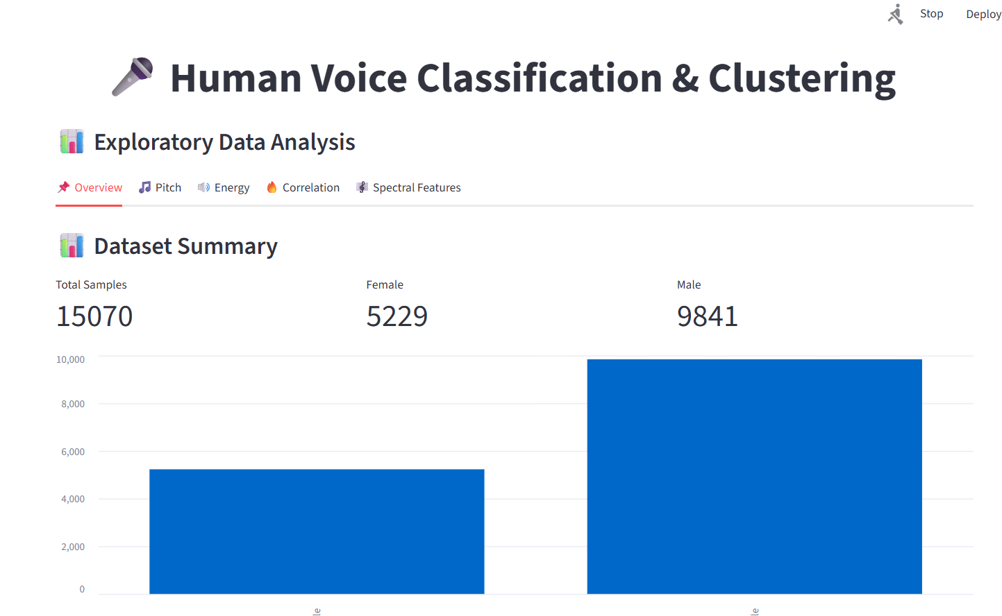
Slide 10: Streamlit Deployment
Web Application Features
Dataset viewer
EDA page
Prediction page
Clustering page

